Slide 1

Predicting the success/failure of
projects
Ntandokayise Chuma
Prasenjit Choudhury

Slide 2
Kickstarter helps artists, musicians, filmmakers, designers, and other creators find the resources and support they need to make their ideas a reality.
To date, tens of thousands of creative projects — big and small — have come to life with the support of the Kickstarter community.
Over 10 million people, from every continent on earth, have backed a Kickstarter project.

Slide 3

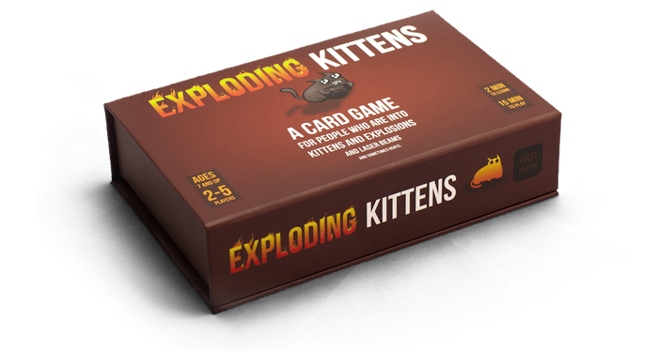
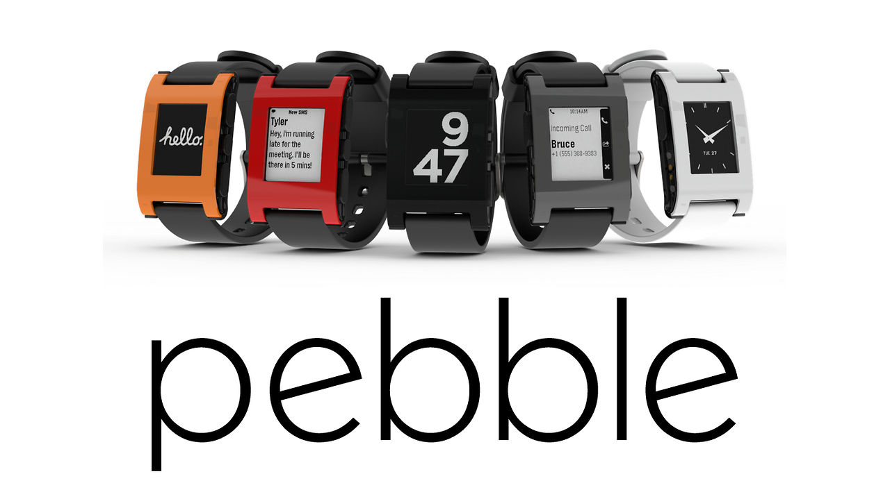
The big problem
With so many Kickstarter projects online, can we use past data to predict whether a Kickstarter project would be a success or failure in reaching the funding target?
Notes:
Pebble: $20M
Baubax: $9.2M
Exploding Kittens: $8.8M

Slide 4
Who cares?
As a backer: Will I get the project or item that I have put my money towards?
As Kickstarter company: Will this project meet its funding goal so that we get to generate revenue? ( Kickstarter charges 5% flat fee + $0.20/backer transaction fee - IF the project meets funding goal)
Notes:
Pebble: $20M
Baubax: $9.2M
Exploding Kittens: $8.8M

Slide 5
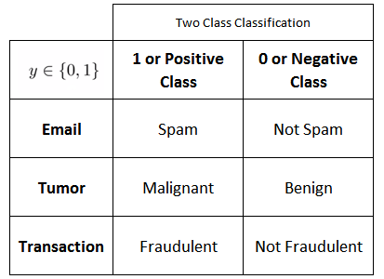
What kind of problem is this
This is a classification problem when independent variables are continuous in nature and dependent variable is in categorical form. That’s why the answers to such problems are in categorical form i.e. Yes or No.

Slide 6
Logistic Regression
The logistic model is used to model the probability of a certain class or event existing such as pass/fail, win/lose, alive/dead or healthy/sick.
Is the image that of a cat or a dog?
Should we accept an application or not?
Is a product defective or not?
It essentially extends idea of linear regression to situation where outcome variable is categorical (not continuous)

Slide 7
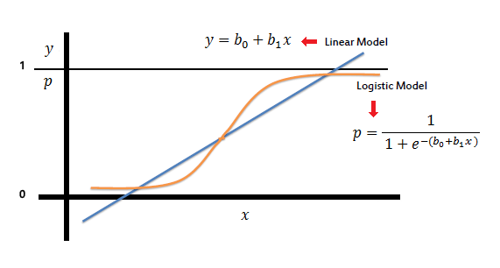
Why Logistic Regression?
The benefit that Logistic Regression provides over Linear Regression is that it predicts outcomes with probabilities.
So rather than only predicting a Pass/Fail, Y/N etc. - it predicts Pass/Fail, Y/N etc. with a probability (80%, 90% etc.)
Also, Logistic Regression can work well with both Continuous Values (1,2,3,4...) and Discrete Values (0/1, Y/N, Dead/Alive) etc. to predict outcomes

Slide 8
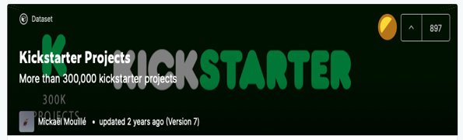
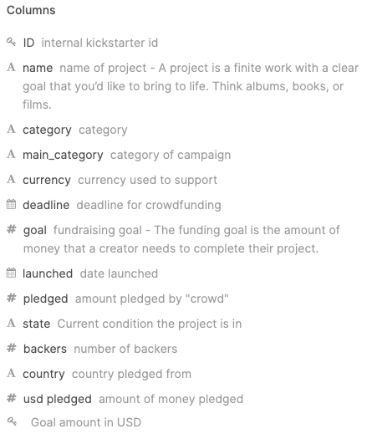
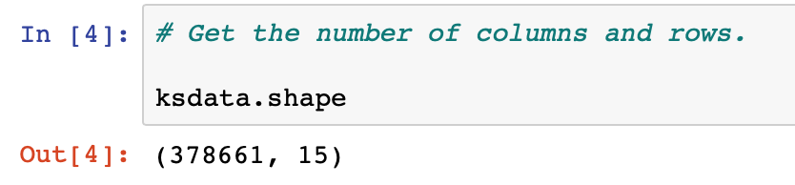
Data collection
We found our data source on Kaggle: https://www.kaggle.com/kemical/kickstarter-projects/

Slide 9
Data cleansing
Delete any bad data from the raw file
We didn’t need to as the file had no NaN
Standardize targets into a single currency (USD)
Use the field - “goal (converted to USD)”
Use the field - “pledged (converted to USD)”
Identify non-significant variables and drop:
Id, name, category, launched (date), deadline (date), goal (home currency), pledged (home currency), currency
Create dummy variables for string value data:
Main Category
Country
State

Slide 10
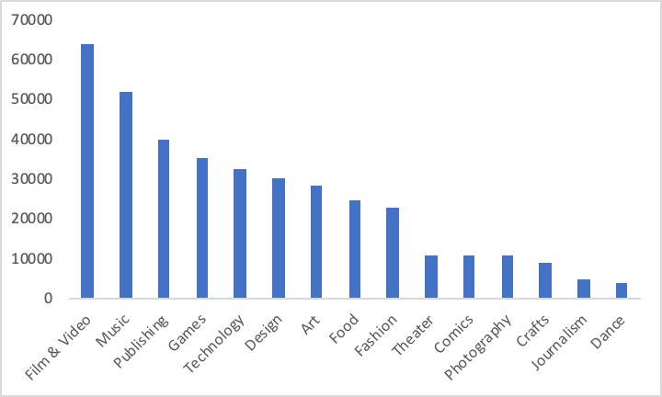
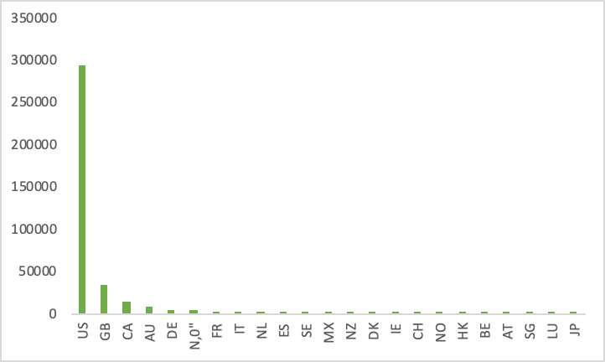
Interesting visualizations
Distribution of project categories
Distribution of countries

Slide 11
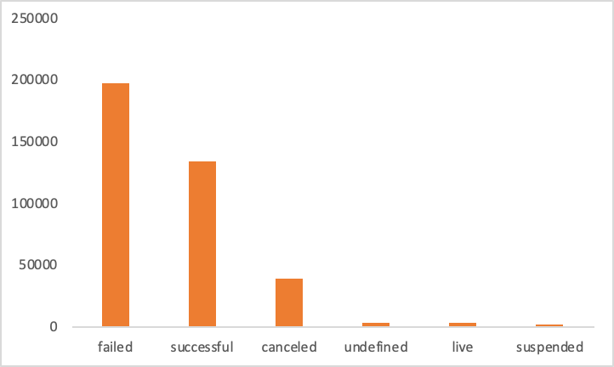
Interesting visualizations
Distribution of project states

Slide 12
Running the model
We start with: 44 independent variables
Majority being dummy variables
We’ll look at 3 scenarios to come up with the best model

Slide 13
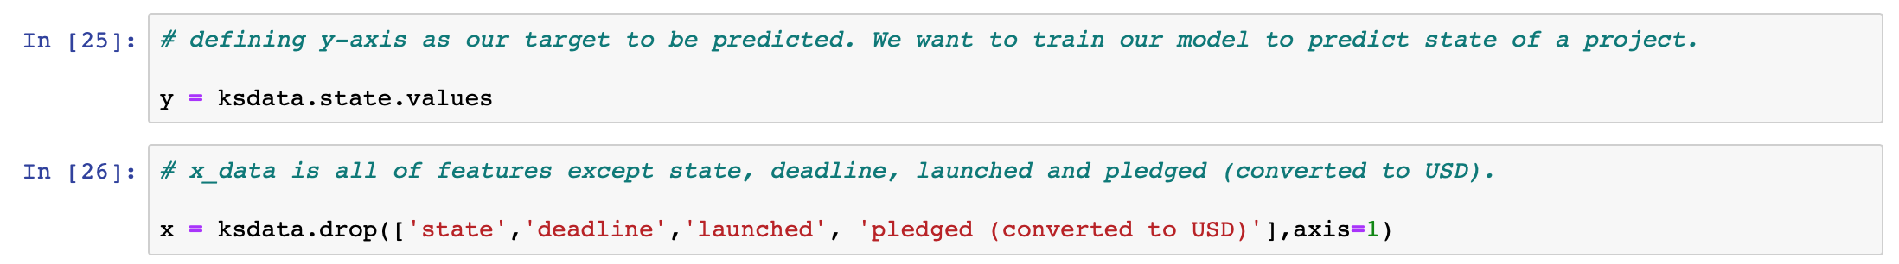
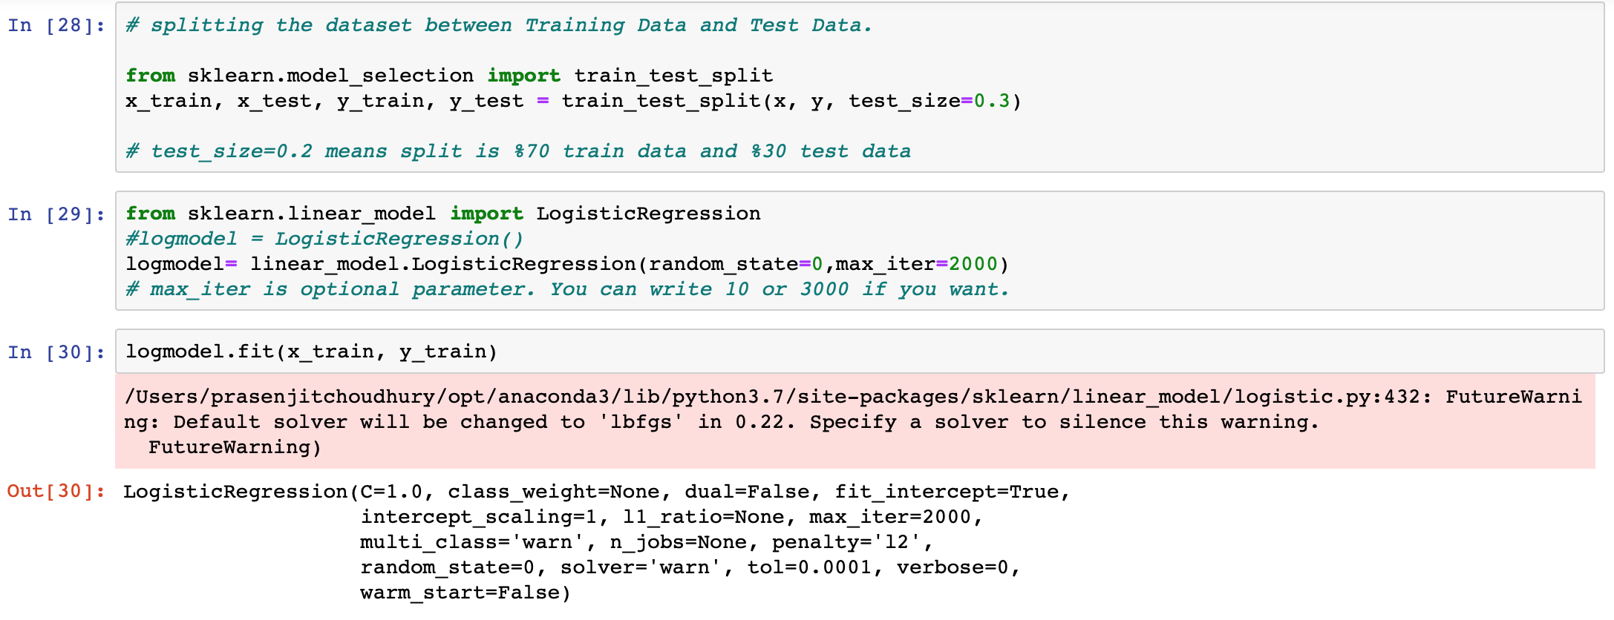
Running the model - Scenario 1
Notes:
State = successful or failed
Dropping deadline, launched (both time), because they were causing the model to slow down and formatting them to work in was hard.
Dropping pledged () because it was causing the model to over fit when goal in is in the mix as well..

Slide 14
Evaluating the model...
We’ll use the following library or similar to evaluate our model:
“from sklearn.metrics import accuracy_score, classification_report, precision_score, recall_score”
We’ll then assess the model’s:
Confusion Matrix
(true positives, false positives, etc.)
Source: https://www.kaggle.com/mnassrib/titanic-logistic-regression-with-python
Notes:
Accuracy score: the fraction of samples predicted correctly.
Recall (also known as sensitivity): is the fraction of positives events that you predicted correctly.
Precision: is the fraction of predicted positives events that are actually positive
The f1 score: is the harmonic mean of recall and precision, with a higher score as a better model.

Slide 15
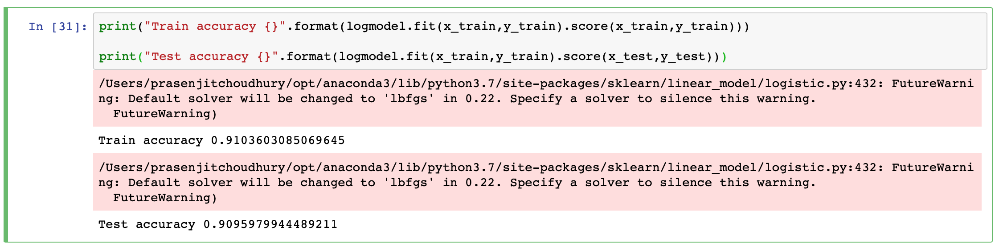
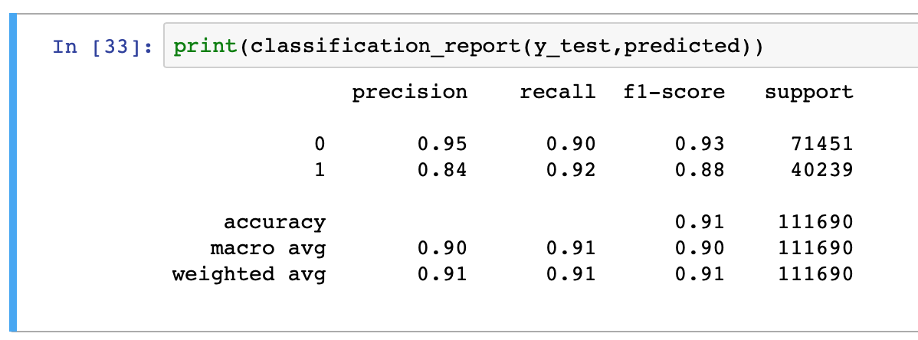

Evaluation

Slide 16
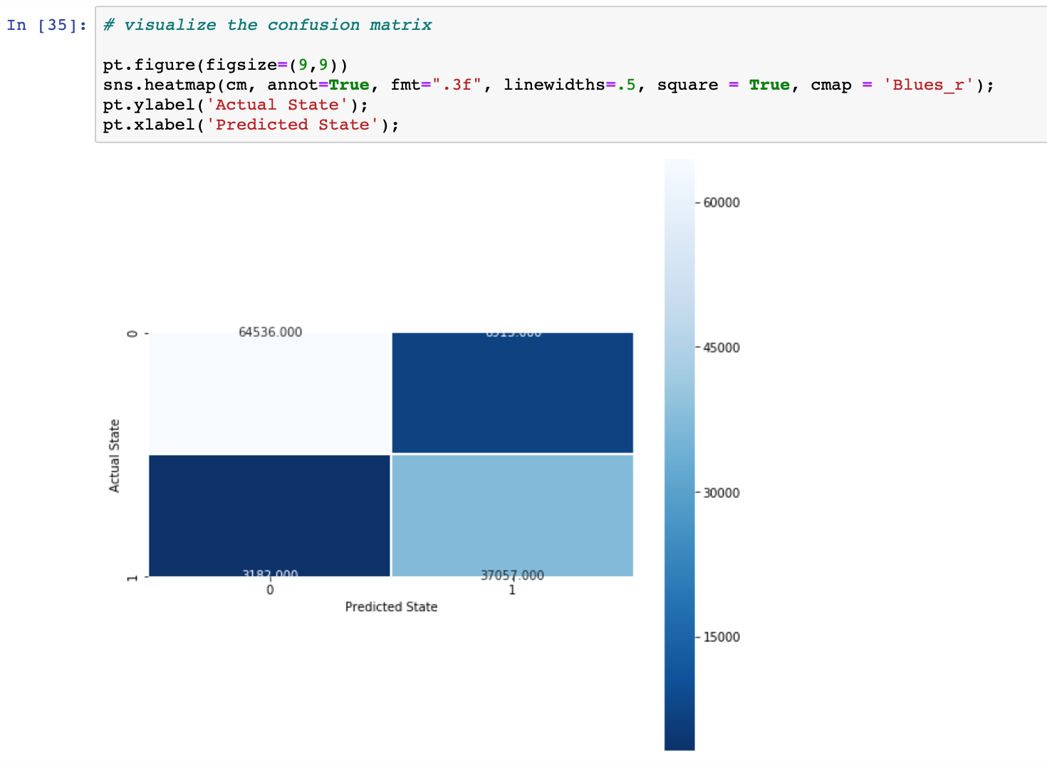
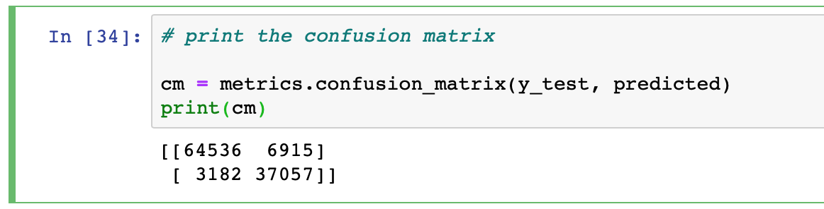
Evaluation
Notes:
True Positive - You predicted positive and it’s true (top left). True Negative: You predicted negative and it’s true. False Positive - You predicted positive and it’s false. False Negative - You predicted negative and it’s false.

Slide 17
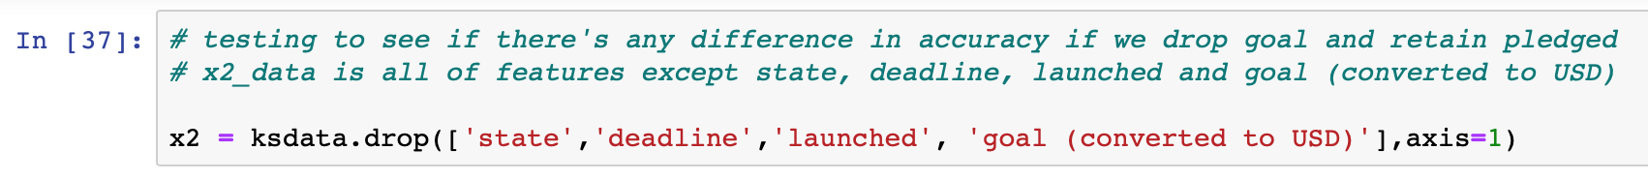
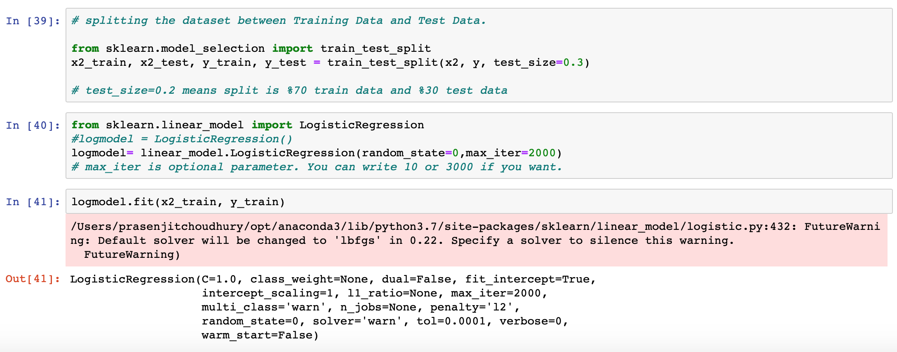
Running the model - Scenario 2

Slide 18
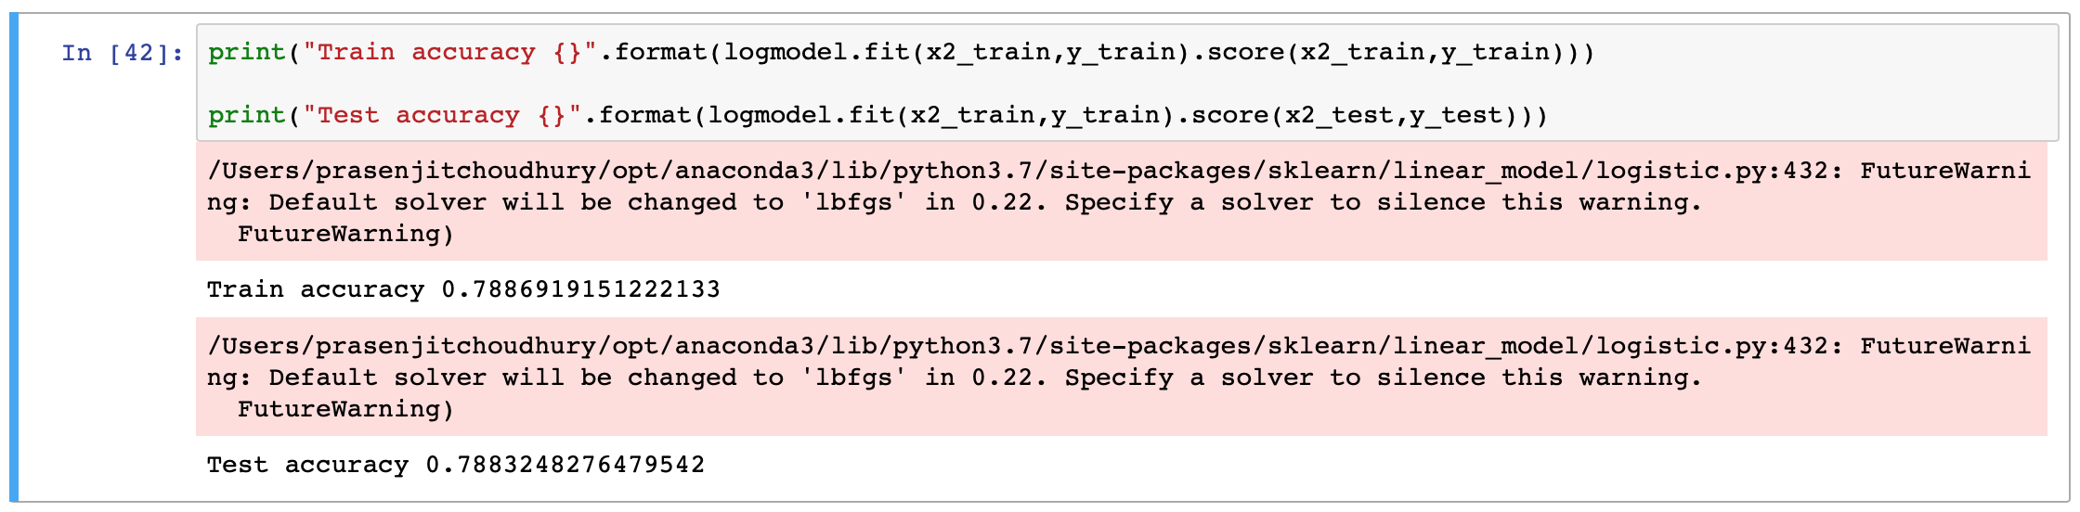
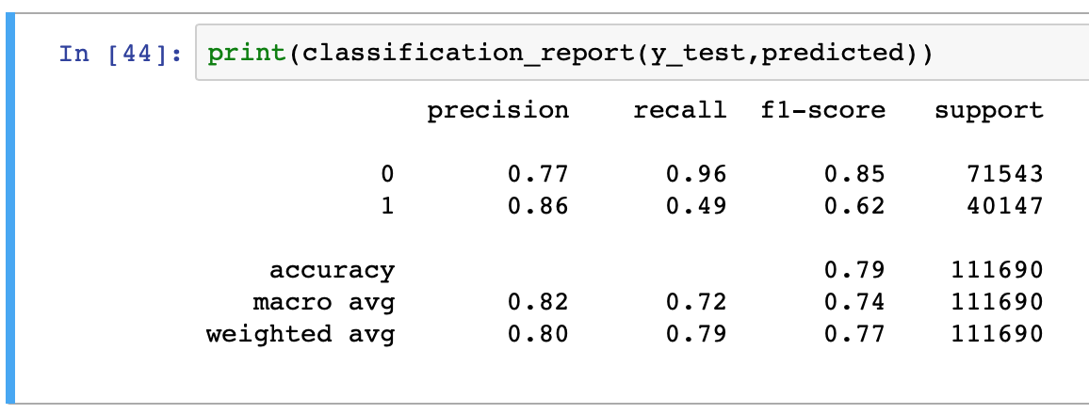
Evaluation

Slide 19
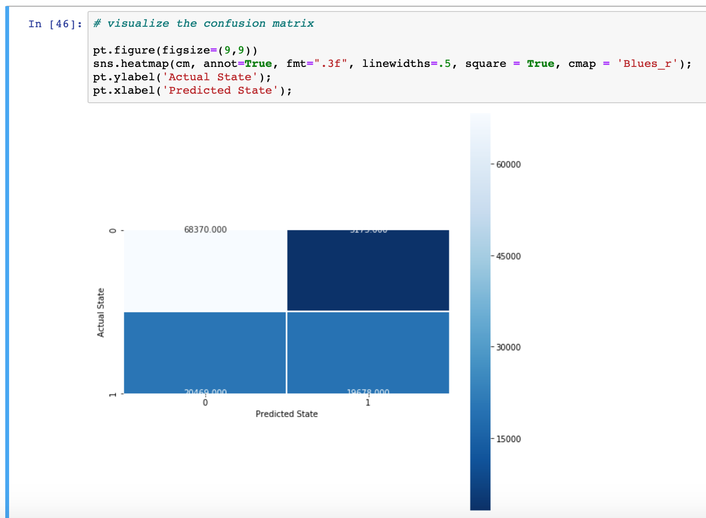
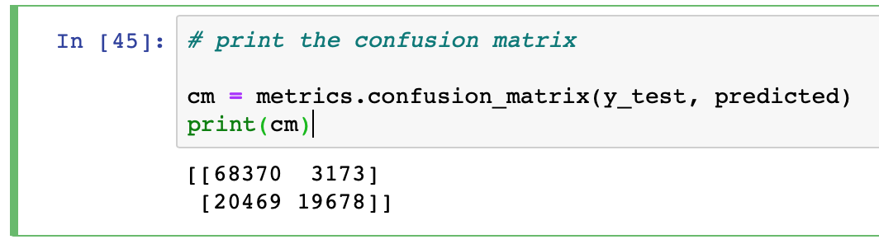
Evaluation

Slide 20
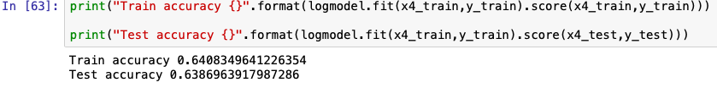

Running the model - Scenario 3
Notes:
Conclusion - best model = model 1

Slide 21
THANKS!
Any questions?

Slide 22
Credits
Special thanks to all the people who made and released these awesome resources for free:
Presentation template by SlidesCarnival
Illustrations by Sergei Tikhonov
Photographs by Unsplash

